Slide 1
Malarial parasites
By Mrs. Mamita Rai Gurung

Slide 2
Malarial parasites belong to genus Plasmodium.
The genus of the class of Sporazoa that includes the parasite that causes malaria.
Plasmodium is a type of protozoa, a single-celled organism that is able to divide only within a host cell.
There are more than 100 species of Plasmodium, which can infect many animal species such as reptiles, birds, and various mammals.
The main types of Plasmodium are
P. falciparum, the species that causes falciparum malaria, the most dangerous type of malaria;
P. malariae, the species that causes quartan malaria;
P. ovale, a species found primarily in east and central Africa that causes ovale malaria; and
P. vivax, the species that causes vivax malaria, which tends to be milder than falciparum malaria.

Slide 3
General characteristics
Malarial parasites responsible for causing malaria
Malarial parasites Infects blood, lymphatic system and immune system
Shows alternation of generation accompanied by alternation of host.
Schizogony (asexual cycle) takes place inside erythrocytes in human host, Sporogony (sexual cycle) takes place in the mosquito.
Typically, pigment is produced in erythrocytes during the developmental stages of parasites which are visualised by light microscope.
4 species are encountered in human disease: P falciparum, P vivax, P ovale and P malariae.

Slide 4
P. falciparum, which is found worldwide in tropical and subtropical areas, and especially in Africa where this species predominates. P. falciparum can cause severe malaria because it multiples rapidly in the blood, and can thus cause severe blood loss (anemia). In addition, the infected parasites can clog small blood vessels. When this occurs in the brain, cerebral malaria results, a complication that can be fatal.
P. vivax, which is found mostly in Asia, Latin America, and in some parts of Africa. Because of the population densities especially in Asia it is probably the most prevalent human malaria parasite. P. vivax (as well as P. ovale) has dormant liver stages ("hypnozoites") that can activate and invade the blood ("relapse") several months or years after the infecting mosquito bite.
P. ovale is found mostly in Africa (especially West Africa) and the islands of the western Pacific. It is biologically and morphologically very similar to P. vivax. However, differently from P. vivax, it can infect individuals who are negative for the Duffy blood group, which is the case for many residents of sub-Saharan Africa. This explains the greater prevalence of P. ovale (rather than P. vivax ) in most of Africa.
Notes:
Duffy antigen is located on the surface of red blood cells, and is named after the patient in which it was discovered.

Slide 5
P. malariae, found worldwide, is the only human malaria parasite species that has a quartan cycle (three-day cycle). (The three other species have a tertian, two-day cycle.) If untreated, P. malariae causes a long-lasting, chronic infection that in some cases can last a lifetime. In some chronically infected patients P. malariae can cause serious complications such as the nephrotic syndrome.

Slide 6
Life cycle
In human (Asexual cycle)
After mosquito bite, the sporozoites present in salivary gland enters the blood stream and carried to liver.
In liver cell, they undergo a process of multiple nuclear division followed by cytoplasmic division (schizogony). The liver cell then ruptures releasing several thousands of merozoites.( Exoeryhrocyctic cycle)
These merozoites then penetrate RBCs and adopt signet ring morphology.

Slide 7
Inside RBCs, the trophozoites undergo nuclear division (erythrocytic schizogony) and depending upon species 8-24 nuclei are produced before cytoplasmic division.
The RBCs then rupture to release merozoites which then infects fresh RBCs.
Some merozoites inside RBCs develop into male and female gametocytes (instead of erythrocytic schizogony)

Slide 8
Inside mosquito (sexual cycle)
During blood meal, female anopheles mosquito ingests RBCs containing gametocytes.
In the gut of mosquito, the RBCs produce female macrogamete and male microgametes.
Then the nuclear material and cytoplasm of male gametocytes differentiate to form several gametes, a flagellated body.
The gametes detach and penetrate female gametocyte forming ookinete.

Slide 9
The ookinete penetrates the midgut and settle on body cavity as oocyst.
Within oocyst several sporozoites are formed which after rupture migrate to salivary gland of mosquito so that during next blood meal, the sporozoites are injected in the humans.

Slide 10
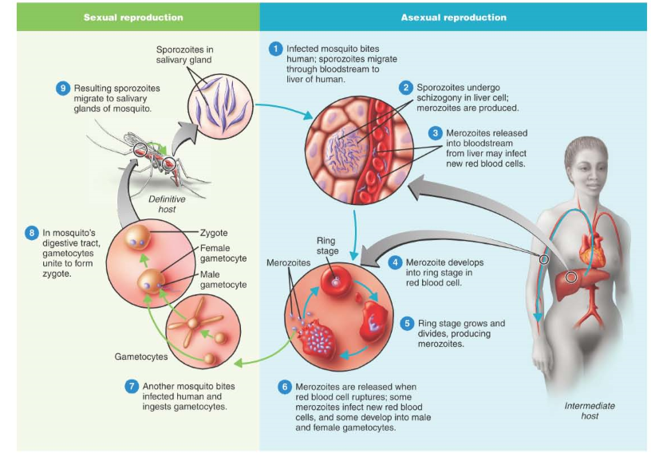

Slide 11
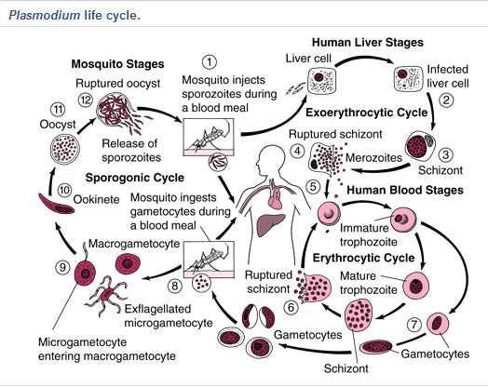

Slide 12
Pathogenesis/ clinical manifestation
Incubation period: around 2 weeks
Malaria is characterised by high fever, severe chills and sweatening followed by headache, muscle pain and vomitting.
Most pathogenic findings of malaria results from the destruction of RBCs.
Splenomegaly occurs in all forms of malaria with enlarged spleen.
Anaemia and jaundice are also features of malaria, particulary falciparum malaria.

Slide 13
Malaria caused by P falciparum is more severe than that caused by other plasmodium.
It is characterised by far more destruction of red cells than others and by occulsion of the capillaries with aggregrates of parasitised red cells.
This leads to life threatening haemorrhage and necrosis particularly in brain, kidney damage, haemoglobinuria, black water fever.
Notes:
Necrosis-the death of most or all of the cells in an organ or tissue due to disease, injury, or failure of the blood supply
excretion of free haemoglobin in the urine.
Blackwater fever is a complication of malaria infection in which red blood cells burst in the bloodstream (hemolysis), releasing hemoglobin directly into the blood vessels and into the urine,

Slide 14
Lab diagnosis
Sample: blood (peripheral blood before antimalarial treatement)
Microscopy
Light microscopy is the gold standard method for malaria confirmation which depends upon demonstration of parasites in a stained peripheral blood smear.
Ring forms and gametocytes are most commonly seen in peripheral blood.
Smears (thick and thin) are prepared from peripheral blood and stained with Romanowsky’s stain (leishman, Field’s, Wright or Giemsa stain)
Notes:
Peripheral blood cells are the cellular components ofblood, consisting of red blood cells (erythrocytes), white blood cells (leucocytes), and platelets, which are found within the circulating pool of blood and not sequestered within the lymphatic system, spleen, liver, or bone marrow

Slide 15
Giemsa stain
Mainly used to stain malaria parasite, trypanosomes, leishmanial parasites and microfilariae.
The film is fixed with absolute methanol for 2-3 mins.
The slide is allowed to dry and immersed in 1:10 dilution of Giemsa stain in buffered distilled water for 30 mins.
The slide is then washed in buffered distilled water to remove excess stain and allowed to dry.
It is then observed in oil immersion lens.

Slide 16
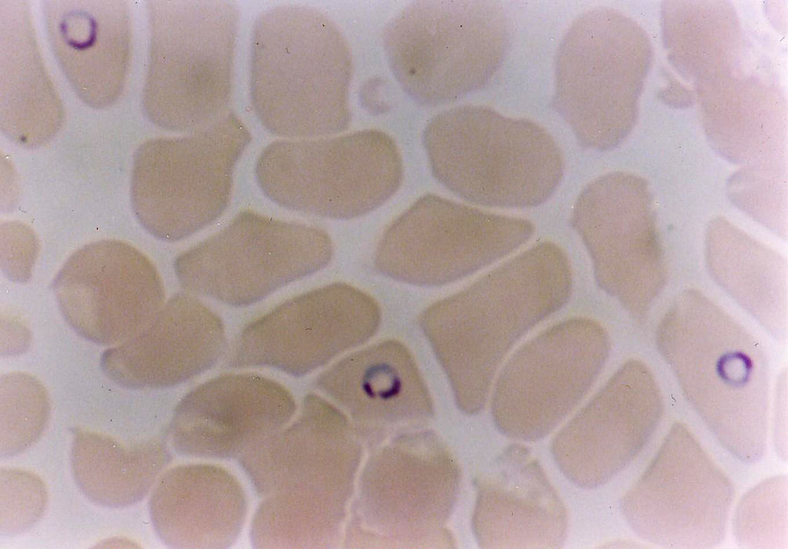
Giemsa-stained thin blood film showing Plasmodium falciparum infections

Slide 17

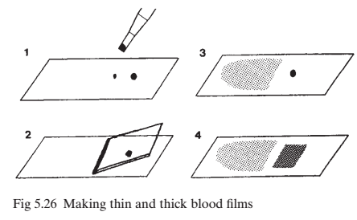
Thick smear
Thin smear
Used for
Parasite detection
Quantitating parasitaemia
Demonstrating malarial pigments.
NOT used for species diagnosis
Principle: during preparation of smear, concentrated RBCs are lysed with distilled water showing intact parasites. The smear is dried and stained without fixing.
Used for
Detecting parasites
Determining the species of the parasites.
Thin smears are air dried, fixed with alcohol and stained. Then the RBCs in the tail end of smear are examined.

Slide 18
Thin blood film
Wipe the pulp of finger withspirit and allow to dry.
Prick with sterile surgical needle asceptically.
Squeeze the finger and put a drop of blood on the edge of clean glass slide.
With the help of another slide held at 30°, pull the blood gently to the opposite end.
Allow the film to dry.
If the smear is to be stained, fix the film by covering it with aboslute methanol or ethanol for 2-3 mins to prevent dehaemoglobinization. (for alcohol stains or leishman stain, this treatement is not required.
Notes:
dehemoglobinized (lysed) red blood cells (RBCs) which provides better opportunity to detect parasitic

Slide 19
Thick blood film
Put a thick drop of blood on a slide and spread with the edge of another slide (or by needle) to form an area of about 12mm square.
Stir the blood continuously for about 30 sec to prevent formation of fibrin clots (if anticoagulated blood is used stirring is not required)
Allow the film to air dry in a dust free area.
Dehaemoglobinize the film by placing in distilled water in a vertical position for 5-10 mins.
Allow to dry the film.
Observe under microscope

Slide 20
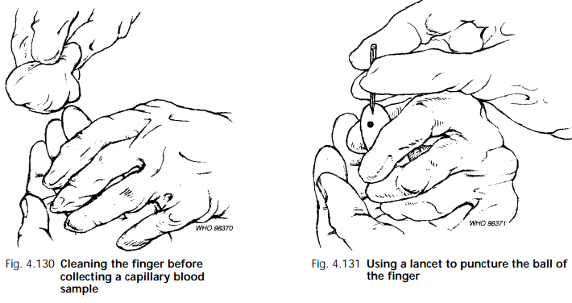
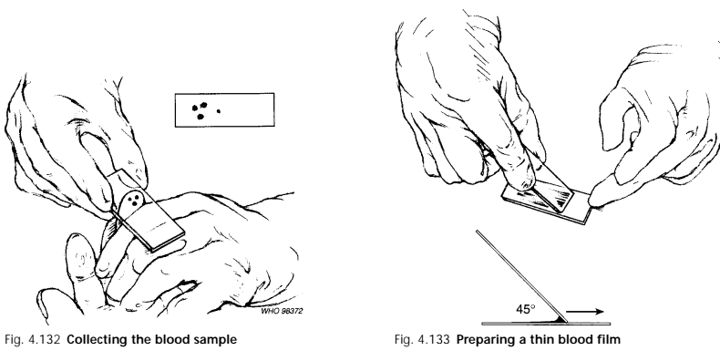
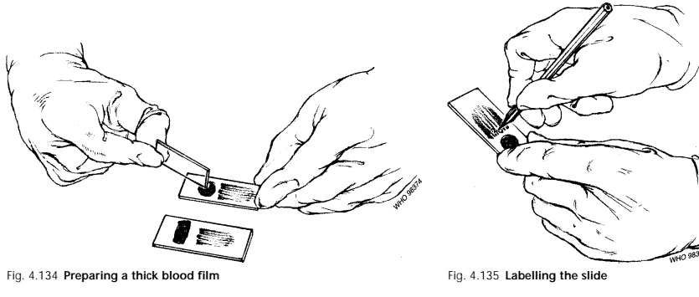

Slide 21
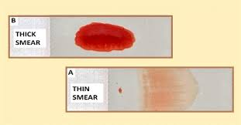

Slide 22
Other microscopic methods
Fluorescence microscopy
It uses staining of blood smears with acridine orange where DNA is stained green and RNA are stained red after observation in Fluorescence microscope.
QBC malarial test(Quantitative Buffy Coat)
The quantitative buffy coat (QBC) technique is a method of diagnosing malarial parasites based on micro-centrifugation, fluorescence, and density gradient of infected red blood cells. Uses acridine orange to stain nucleic acids.
Blood samples are collected in a special tube containing acridine orange, an anticoagulant, and a float, and then are centrifuged in a microhematocrit centrifuge.
More sensitive than thick blood smear (can detect as low as 3-4 parasites/μl of blood.
But don’t identify the species and is expensive ans sophisticated.

Slide 23
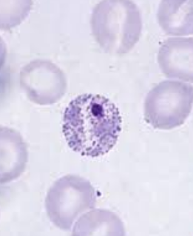
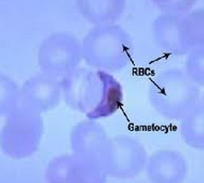
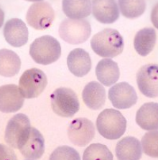

Slide 24
Serodiagnosis
Used for identify the infected donors in case of transfusion malaria.
Confirm past malaria in patients
For epidemiological survey
Antibody detection tests
-Indirect haemagglutination
-Indirect fluorescent antibody test
-ELISA
Antigen detection tests
ELISA inhibition test
Dipstick test

Slide 25
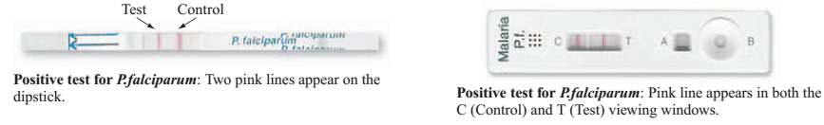

Slide 26
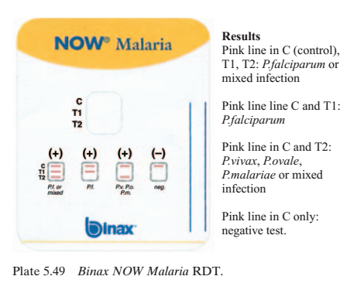
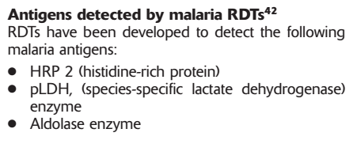

Slide 27
Molecular diagnosis
Sensitive methods and specific
Useful for species identification and for drug resistance parasites.
PCR can also be performed on dried blood spots and is useful tool for epidemiological study.
Methods
DNA probe
PCR

Slide 28
Other tests
Leucopenia
High ESR(Erythrocytes sediments rate)
Reduced platelet count
Metabolic acidosis
Hypergammaglobulinaemia
etc
Notes:
Leukopenia is a decrease in the number of white blood cells (leukocytes) found in the blood.
Metabolic acidosis is a condition that occurs when the body produces excessive quantities of acid
Hypergammaglobulinemia is a medical condition with elevated levels of gamma globulin

Slide 29
Treatement
Antimalarial drugs like chloroquine, amodiaquine, chloroguanide, pyrimethamine, artemisinin, sulfonamides
Supportive therapy like
Antipyretics and cooling blankets
Fluid and electrolyte balance
Blood transfusion to treat severe anemia
Parental glucose infusion to treat hypoglycemia
Incubation and assisted ventilation

Slide 30
Prevention and control
Treatement of infected individuals
Reduction in malaria transmission by
Controlling mosquito population (spraying insecticides like DDT or malathion, spraying oils and chemicals in breeding sites, eliminating bleeding sites like lagoons, swamps)
Preventing mosquito bites (using mosquito nets, using protective clothes, using mosquito repellents)
chemoprophylaxis

